Slide 1

Amdahl’s Law
Presented by:
Elizer Ponio Jr.
Department of Computer Science
College of Computing and Information Technologies

Slide 2
Introducing Amdahl’s Law
Amdahl's Law has been used by computer scientists for more than 55 years, and it continues to impact the way we design and optimize our computing systems today.
It is a principle used to provide guidance when making decisions regarding the optimization of system performance, often in the realm of parallel computing.

Slide 3
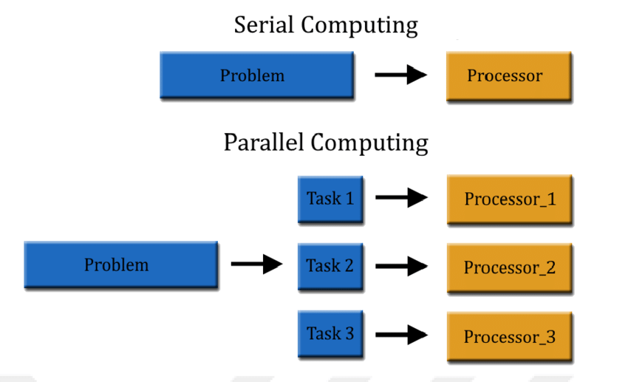
Sequential vs Parallel Computing

Slide 4
Introducing Amdahl’s Law
The basis of the law states that the maximum potential improvement in speed of a program or system is limited by its most significant bottleneck which is the portion of the system or program that takes the longest to complete.

Slide 5
Introducing Amdahl’s Law
Amdahl's Law is popular among developers because it offers a simple and efficient way to determine the maximum potential for improving system performance.
By identifying the bottleneck in a program or system, developers can focus their efforts on optimizing that particular component instead of wasting time working on parts that will have minimal returns.

Slide 6
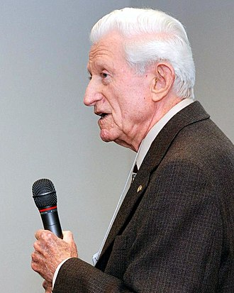
Parallel processing & the origin of Amdahl's Law
Amdahl’s Law is named after Gene Amdahl, an American computer scientist who focused on enhancing computer performance using different methods, including parallel computing.
Parallel computing is when multiple processors, cores, and computers are used to perform many tasks or calculations simultaneously. This helps to speed up data processing and computation allowing for greater scalability than traditional methods.

Slide 7
Parallel processing & the origin of Amdahl's Law
However, adding more processors to a system does not automatically make things faster with parallel computing. We need to identify the limitations of the system as a whole
parallelizable
serial/sequential
One core
Two cores
Three cores
Four cores

Slide 8
parallelizable
serial/sequential
One core
Two cores
Three cores
Four cores
If 50% of the execution time is sequential, the maximum speedup is 2, no matter how many cores you use

Slide 9
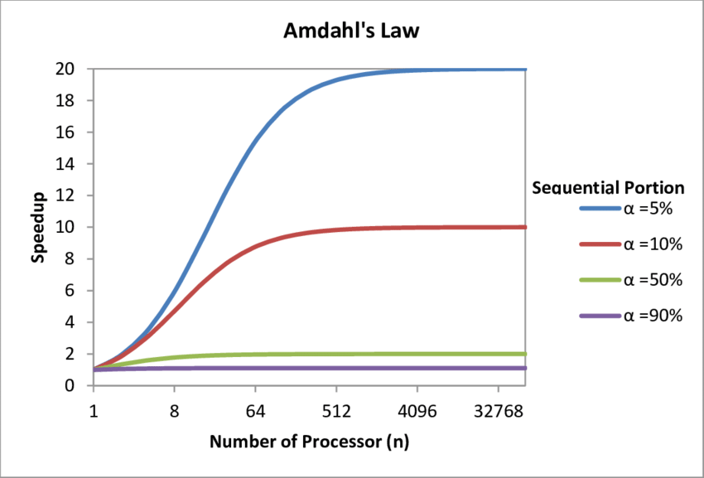

Slide 10
What is Amdah’s Law?
Amdahl's Law is a formula that predicts the potential speed increase in completing a task with improved system resources while keeping the workload constant.
The theoretical speedup is always limited by the part of the task that cannot benefit from the improvement.

Slide 11
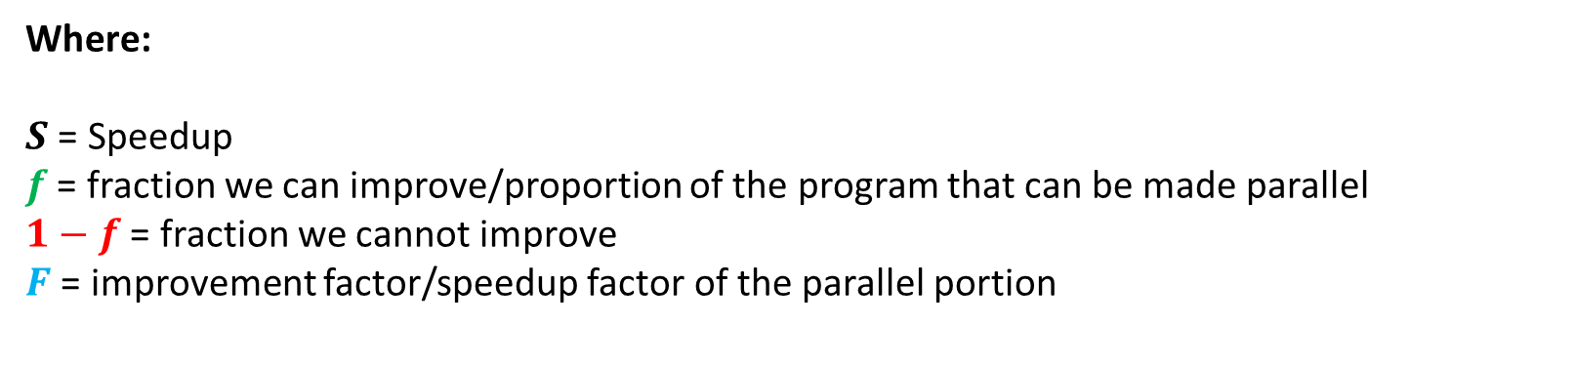
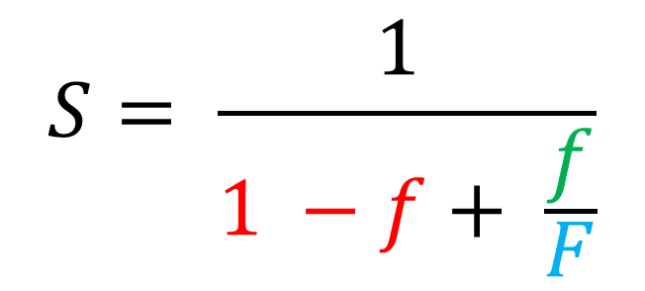
What is Amdah’s Law?
$$S= \frac{1 }{1 −f+ \frac{f}{F}}$$
Where:
$S$ = Speedup
$f$ = fraction we can improve/proportion of the program that can be made parallel
$1−f$ = fraction we cannot improve
$F$ = improvement factor/speedup factor of the parallel portion

Slide 12
Examples of Amdahl’s Law
Example 1: Team meeting
Your company has scheduled a meeting with 3 team members first thing in the morning. Each team member needs to get themselves to the office, but they can't start the meeting until everyone has arrived.
Two of the sales members drive themselves into the office, while the third teammate rides their bicycle.
According to Amdahl’s Law, if the team wants to start their meetings earlier, then they need to focus on the performance of the cyclist. Even if one of the drivers drives faster than usual, there's still no way to get around the fact that they have to wait for the bicyclist who is the bottleneck in this situation.

Slide 13




Examples of Amdahl’s Law

Slide 14
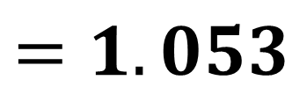
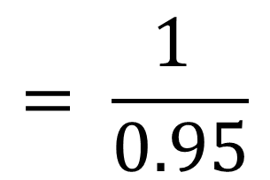
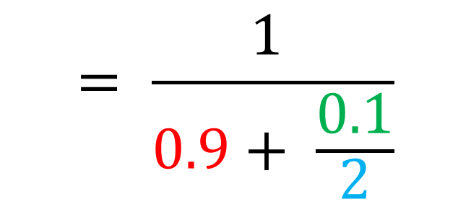
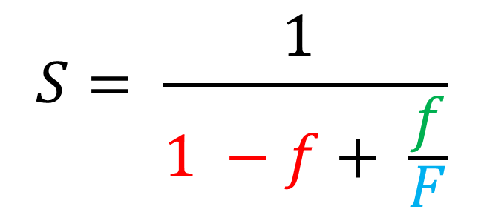
Examples of Amdahl’s Law
Example 2:
Your team member discovered a way to improve floating point instructions 2X as fast, but only 10% of all executed instructions are floating point
$$S= \frac{1 }{1 −f+ \frac{f}{F}}$$
$$= \frac{1 }{0.9+ \frac{0.1}{2}}$$
$$= \frac{1 }{0.95}$$
$$=1.053$$

Slide 15
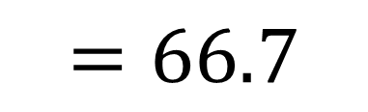
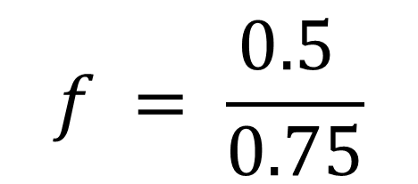
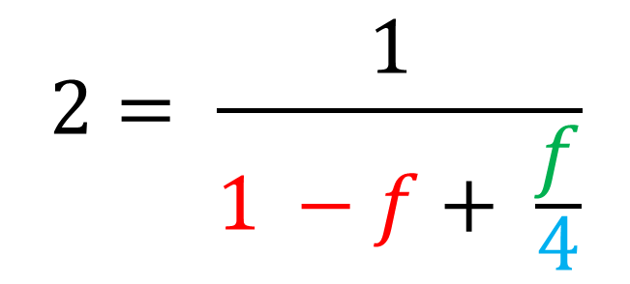
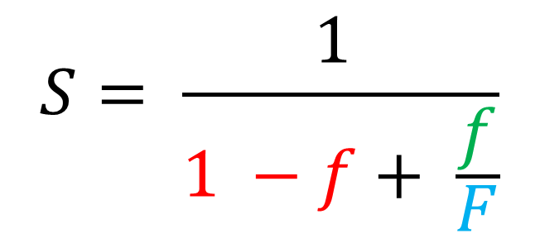
Examples of Amdahl’s Law
Example 2:
We want the overall speedup of 2 and can accelerate floating point instructions by 4X
$$S= \frac{1 }{1 −f+ \frac{f}{F}}$$
$$2= \frac{1 }{1 −f+ \frac{f}{4}}$$
$$f = \frac{0.5 }{0.75}$$
$$=66.7$$

